Slide 1
Litho R2R UI Layout
Presenter’s Name
Presenter’s Title, etc.
Event name and date

Slide 2
Main Ribbon
Main
Theme
Process Setting
Context
Setting
Varname
Mapping
Material
View
Special
Job
Process Record
Litho
Config
Lot Run History
Tool
Status
Tool
Product
Configuration
Operation
Global
History

Slide 3
Any Change
Confirm
Comment
Password
OK
Cancel

Slide 4
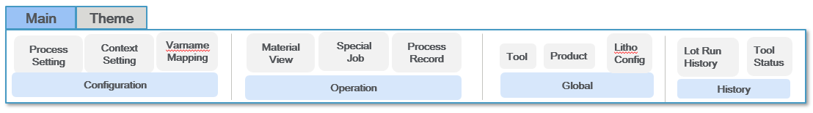
Process Task Ribbon
Main
Theme
Task
New
Edit
Copy To
Delete
Batch Edit
History
Process
Process Setting

Slide 5
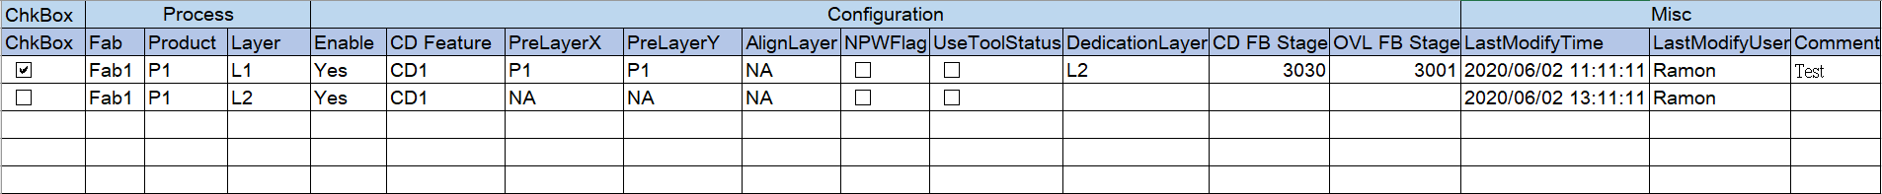
Process Setting
ProductId
The chkeckList box for product
(default : none check)
Configuration
History
Layer
The chkeckList box for Stage
(default : all check)
Enable
PreLayer X:
Align Layer
Dedication Layer
CD Feature
PreLayer Y:
NPW Flag
CD FB Stage
Priority 1:
Use Tool Status
OVL FB Stage
Enabled/Disaeble
Priority 2:
The chkeckList box for Enabled or disabled
(default:all check)
Priority 3:
Priority 4:
Priority 5:

Slide 6
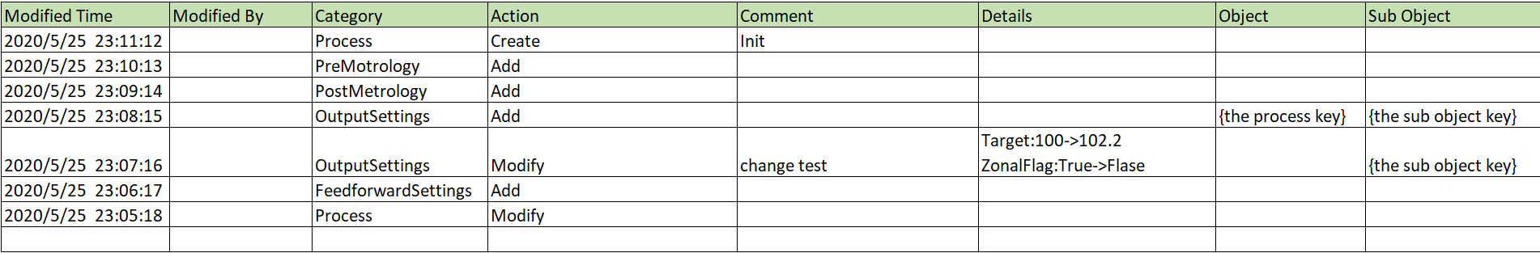
Process Setting
ProductId
The chkeckList box for product
(default : none check)
Configuration
History
Layer
The chkeckList box for Stage
(default : all check)
Enabled/Disaeble
The chkeckList box for Enabled or disabled
(default:all check)

Slide 7
Create Process Window
New Process
Process
Option
Enable Control
*
Fab
*
PreLayer X:
Use Tool Status
*
PreLayer Y:
NPW Flag
*
Product
*
CD Feature
PreLayer Search Priority
*
Layer
Align Layer
Priority 1:
Dedication Layer
Priority 2:
*
Enable
CD FB Stage
Priority 3:
Priority 4:
OVL FB Stage
Priority 5:
Create
Close
Confirm
Comment
Password
OK
Cancel

Slide 8
Edit Process Window
Edit Process
Process
Option
Enable Control
*
Fab
*
PreLayer X:
Use Tool Status
*
PreLayer Y:
NPW Flag
*
Product
*
CD Feature
PreLayer Search Priority
*
Layer
Align Layer
Priority 1:
Dedication Layer
Priority 2:
*
Enable
Priority 3:
CD FB Stage
Priority 4:
OVL FB Stage
Priority 5:
Save
Close
Confirm
Comment
1. Process 的Key Column 不能修改，只读
Password
OK
Cancel

Slide 9
Batch Edit Process Window
Batch Edit Process
Process
Option
Enable Control
*
Enable
Use Tool Status
*
PreLayer X:
NPW Flag
*
PreLayer Y:
PreLayer Search Priority
*
CD Feature
Priority 1:
Align Layer
Priority 2:
Dedication Layer
Priority 3:
CD FB Stage
Priority 4:
Priority 5:
OVL FB Stage
Save
Close
Confirm
Comment
Password
OK
Cancel

Slide 10
Context Ribbon
Main
Theme
Task
New
Edit
Copy To
Delete
Batch Edit
History
Edit
Batch Edit
History
Context
Spec
Context Setting

Slide 11
Context Setting
ProductId
The chkeckList box for product
(default : none check)
Configuration
Spec
History
Layer
CD
OVL
The chkeckList box for Stage
(default : all check)
Control Flag
Target
Control Flag
OVL Model
FB Effective Days
Dose Sensitivity
FB Effective Days
Chuck Control
FB Allow Count
Rework Bias
FB Allow Count
2D Metrology
Enabled/Disaeble
FB Lot Counter
OOS Threshold
FB Lot Counter
Dedication Type
The chkeckList box for Enabled or disabled
(default:all check)
FB Lot List
Min Point Limit
FB Lot List
OOS Threshold
Assign Pilot
Assign Pilot

Slide 12
Context Setting
ProductId
The chkeckList box for product
(default : none check)
Configuration
Spec
History
Layer
The chkeckList box for Stage
(default : all check)
Enabled/Disaeble
The chkeckList box for Enabled or disabled
(default:all check)

Slide 13
Context Setting
ProductId
The chkeckList box for product
(default : none check)
Configuration
Spec
History
Layer
The chkeckList box for Stage
(default : all check)
Enabled/Disaeble
The chkeckList box for Enabled or disabled
(default:all check)

Slide 14
Create Context By Process
Fab:_____ Product:_____ Layer:_____
If AddContext List all filled
Disable CD/OVL;
Execute Function:
GetDCDContextInfo
GetOVLContextInfo
If return null
Enable CD/OVL; Clear Fileds;
else
Display Values;
Context
AddContext
Tool
Reticle
Recipe
PreTool
PreReticle
CD
OVL
*
Control Flag
*
Target
*
Control Flag
*
OVL Mode
*
FB Effective Days
*
Dose Sensitivity
*
FB Effective Days
*
Chuck Control
FB Allow Count
Rework Bias
FB Allow Count
*
2D Metrology
FB Lot Counter
*
OOS Threshold
FB Lot Counter
*
Dedication Type
FB Lot List
*
Min Point Limit
FB Lot List
*
OOS Threshold
Confirm
Assign Pilot
Assign Pilot
Comment
Create
Close
Password
OK
Cancel

Slide 15
Create Context Window
New Context
Context
*
Fab
*
Reticle
*
Tool
*
Recipe
*
Product
*
PreTool
OOS Threshold (num) : 0-100 default:1
Min Point Limit (num) : bigger than 0 default:1
*
Layer
*
PreReticle
CD
OVL
*
Control Flag
*
Target
*
Control Flag
*
OVL Mode
*
FB Effective Days
*
Dose Sensitivity
*
FB Effective Days
*
Chuck Control
FB Allow Count
Rework Bias
FB Allow Count
*
2D Metrology
FB Lot Counter
*
OOS Threshold
FB Lot Counter
*
Dedication Type
FB Lot List
*
Min Point Limit
FB Lot List
*
OOS Threshold
Assign Pilot
Assign Pilot
Confirm
Create
Close
Comment
Password
OK
Cancel

Slide 16
Edit Context Window
Edit Context
Context
Fab
Reticle
Tool
Recipe
Product
PreTool
Layer
PreReticle
OOS Threshold (num) : 0-100
Min Point Limit (num) : bigger than 0
CD
OVL
*
Control Flag
*
Target
*
Control Flag
*
OVL Mode
*
FB Effective Days
*
Dose Sensitivity
*
FB Effective Days
*
Chuck Control
FB Allow Count
Rework Bias
FB Allow Count
*
2D Metrology
FB Lot Counter
*
OOS Threshold
FB Lot Counter
*
Dedication Type
FB Lot List
*
Min Point Limit
FB Lot List
*
OOS Threshold
Assign Pilot
Assign Pilot
Confirm
Save
Close
Comment
Password
OK
Cancel

Slide 17
Batch Edit Context Window
Edit Context
Context
Right Click
Set as default data
CD
OVL
*
Control Flag
*
Target
*
Control Flag
*
OVL Mode
*
FB Effective Days
*
Dose Sensitivity
*
FB Effective Days
*
Chuck Control
FB Allow Count
Rework Bias
FB Allow Count
*
2D Metrology
FB Lot Counter
*
OOS Threshold
FB Lot Counter
*
Dedication Type
FB Lot List
*
Min Point Limit
FB Lot List
*
OOS Threshold
Assign Pilot
Assign Pilot
Confirm
Save
Close
Comment
Password
OK
Cancel

Slide 18
Spec Settings
Edit Spec Settings
Confirm
Save
Close
Comment
Password
OK
Cancel

Slide 19
Batch Edit Spec
Edit Spec Settings
Context
Right Click
Set as default data
Spec Spec
Confirm
Comment
Close
Password
Save
OK
Cancel

Slide 21
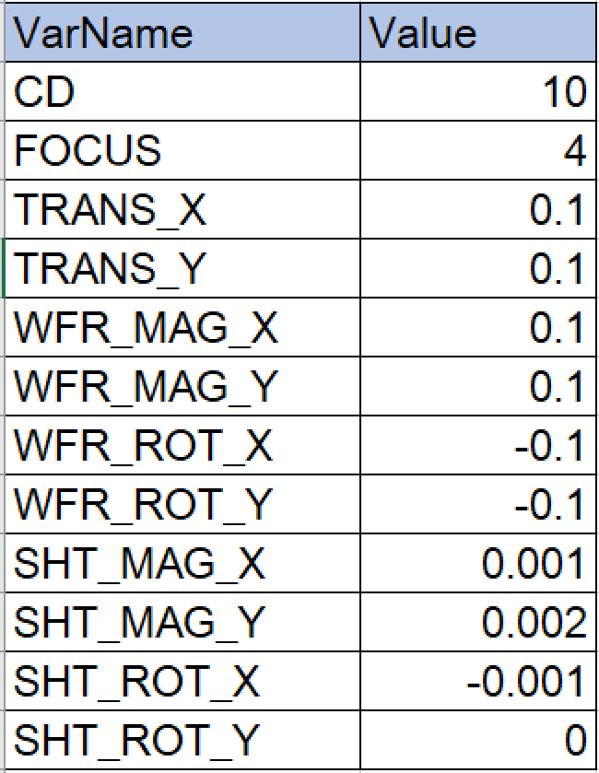
Special Job Ribbon
Main
Theme
Task
New
Edit
Copy To
Delete
History
Special Job Action
Special Job Setting
ProductId
The chkeckList box for product
(default : none check)
Input
History
Layer
The chkeckList box for Stage
(default : all check)
Completed

Slide 22
Special Job - Layout
Special Job Setting
ProductId
The chkeckList box for product
(default : none check)
Input
History
Layer
The chkeckList box for Stage
(default : all check)
Completed

Slide 23
Special Job - Layout
Special Job Setting
ProductId
The chkeckList box for product
(default : none check)
Input
History
Layer
The chkeckList box for Stage
(default : all check)
Completed

Slide 24
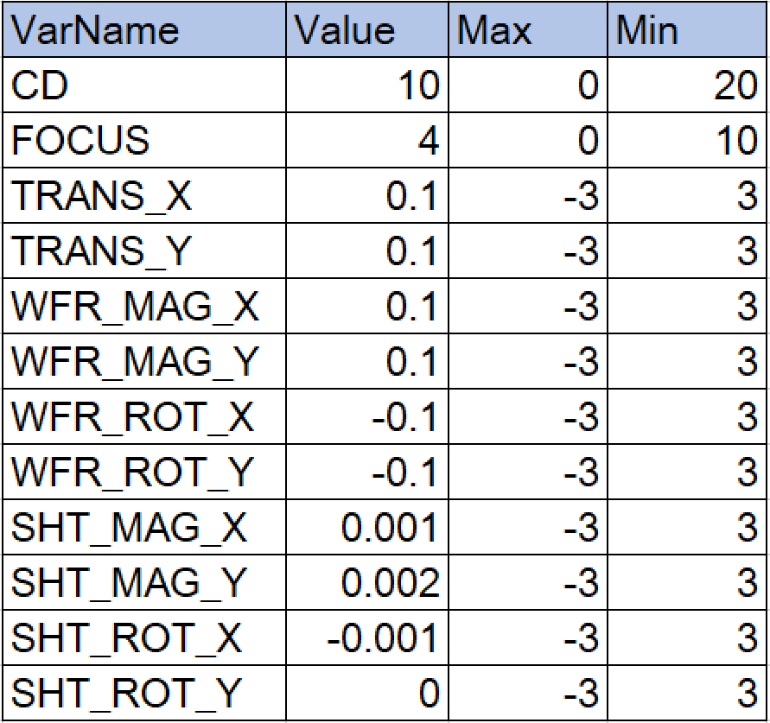
Create Special Job
Lot Check: Lot must input ， Runcard/Split 为 自动填充为NA
Lot unchecked： Lot 自动为NA， Runcard/split must input
Special Job - Create
Context
Special Lot
Special Lot
*
OVLModelName
*
Lot
*
RunCardId
*
SplitId
*
C2C
*
FEM
*
Fab
*
Tool
*
Product
Editable column
*
Layer
*
Reticle
*
Recipe
Create
Close

Slide 25
Edit Special Job
Lot Check: Lot must input ， Runcard/Split 为 自动填充为NA
Lot unchecked： Lot 自动为NA， Runcard/split must input
Special Job - Create
Context
Special Lot
Special Lot
*
OVLModelName
*
Lot
*
RunCardId
*
SplitId
*
C2C
*
FEM
*
Fab
*
Tool
*
Product
Editable column
*
Layer
*
Reticle
*
Recipe
Update
Close

Slide 26
Material View Ribbon
Main
Theme
Task
Edit
History
Create Special Job
Material View Action
Special Job Action
Material View
ProductId
The chkeckList box for product
(default : none check)
Input
Run
History
Layer
The chkeckList box for Stage
(default : all check)

Slide 27
Material View History
Main
Theme
Task
Edit
History
Create Special Job
Material View Action
Special Job Action
Material View
ProductId
The chkeckList box for product
(default : none check)
Input
Run
History
Layer
The chkeckList box for Stage
(default : all check)

Slide 28
Edit Material View – According ChuckControl 1/0
Special Job - Create
Context
Recommend Value
*
Fab
*
Tool
*
Product
*
Layer
*
Reticle
*
Recipe
*
PreTool
*
PreReticle
Control
*
CDControlFlag
CD Assign Pilot
Update
Editable column
*
OVLControlFlag
OVL Assign Pilot
Update
Reset CD
Reset OVL
Close

Slide 29
Edit Material View - 1
Special Job - Create
Context
Recommend Value
*
Fab
*
Tool
*
Product
*
Layer
*
Reticle
*
Recipe
*
PreTool
*
PreReticle
Control
*
CDControlFlag
CD Assign Pilot
Update
Editable column
*
OVLControlFlag
OVL Assign Pilot
Update
Reset CD
Reset OVL
Close

Slide 30
Edit Material View - 2
Special Job - Create
Context
Recommend Value
*
Fab
*
Tool
*
Product
*
Layer
*
Reticle
*
Recipe
*
PreTool
*
PreReticle
Control
*
CDControlFlag
CD Assign Pilot
Update
Editable column
*
OVLControlFlag
OVL Assign Pilot
Update
Reset CD
Reset OVL
Close

Slide 31
Reset CD
Confirm
Reset CDContext: T1:P1:L1:RTL1:RCP1?
Comment
Password
OK
Cancel

Slide 32
Reset OVL
Confirm
Reset OVLContext: T1:P1:L1:RTL1:RCP1:CANON10P:NA?
Comment
Password
OK
Cancel

Slide 33
Process Record Ribbon
Main
Theme
Task
New
Copy To
Delete
New
Delete
Pre Data Config
Chuck Data Config
Process Record

Slide 34
Process Record Config
Pre Data
Chuck Data
ProductId
The chkeckList box for product
(default : none check)
Layer
One row of Pre Data relative to N rows of chuck data.
The chkeckList box for Stage
(default : all check)
Lot

Slide 35
Create Process Record
Process Record - Create
Process Record
*
Lot
*
Product
*
Layer
*
Tool
*
Reticle
Create
Close

Slide 36
Create Chuck Data
Chuck Data - Create
Lot Data
Initial: NA for all dropdownbox
DefaultSetting: C1/C2 cross config
Chuck NA: will not be configed
*
Lot
*
Layer
Wafer Chuck Data
*
#01
C1
*
#06
C1
*
#11
C1
*
#16
NA
*
#21
NA
*
#02
C2
*
#07
C2
*
#12
C2
*
#17
NA
*
#22
NA
*
#03
C1
*
#08
C1
*
#13
C1
*
#18
NA
*
#23
NA
*
#04
C2
*
#09
C2
*
#14
C2
*
#19
NA
*
#24
NA
*
#05
C1
*
#10
C1
*
#15
C1
*
#20
NA
*
#25
NA
DefaultSetting
Create
Close

Slide 38
Tool Ribbon
Main
Theme
Task
Add
Edit
Delete
Tool
Process Setting
Context
Setting
Tool
Setting

Slide 39
Tool Setting
ProductId
The chkeckList box for product
(default : none check)
Configuration
History
Layer
Tool
NameSpace
The chkeckList box for Stage
(default : all check)
ToolVendor
Area
ToolModel
Fab
ProcessType
Enabled/Disaeble
The chkeckList box for Enabled or disabled
(default:all check)
ProcessModel

Slide 40
Global Settings – Tool - Add
Tool
Tool Id
Tool Vendor
Tool Model
Process Type
Popup and to maintain Tools
Process Model
Fab
Save
Close

Slide 41
Global Settings – Tool - Edit
Tool
Tool Id
Tool Vendor
Tool Model
Process Type
Popup and to maintain Tools
Process Model
Fab
Save
Close

Slide 42
Product Ribbon
Main
Theme
Task
Add
Edit
Delete
Product
Process Setting
Context
Setting
Product Setting

Slide 43
Product Setting
ProductId
The chkeckList box for product
(default : none check)
Configuration
History
Layer
Product
The chkeckList box for Stage
(default : all check)
ProductType
Fab
Enabled/Disaeble
The chkeckList box for Enabled or disabled
(default:all check)

Slide 44
Global Settings – Product - Add
Product
Product Id
Product Type
Fab
Popup and to maintain Products
Save
Close

Slide 45
Global Settings – Product - Edit
Product
Product Id
Popup and to maintain Products
Product Type
Fab
Save
Close

Slide 46
LithoConfig Ribbon
Main
Theme
Task
Edit
Add
Delete
Add
Delete
MESNonSkipLotMode
Feedback Exclusion
FEM
Process Setting
Context
Setting
Litho Config
MESNonSkipLotMode
Feedback Exclusion
FEM
MESNonSkipLotMode

Slide 47
LithoConfig – MESNonSkipLotMode - Edit
MESNonSkipLotMode
1. NONE
2. PiLot
3. AnyLot
MESNonSkipLotMode
Popup and to maintain MESNonSkipLotMode
Save
Close

Slide 48
LithoConfig – Feedback Exclusion - Add
Feedback Exclusion
LotType
LotHeader
Fab
Product
Exclusion Type
Value
Popup and to maintain
Feedback Exclusion
Remark
Save
Close

Slide 49
LithoConfig – FEM - Add
FEM
VarName
Index
Popup and to maintain
FEM
Save
Close

Slide 50
Tool Status Ribbon
Main
Theme
Task
Edit
Tool Status
Tool
Status

Slide 51
Tool Status
ToolId
The chkeckList box for product
(default : none check)
Latest Status
History

Slide 52
Tool Status -Edit
Edit Tool Status
Confirm
Save
Close
Comment
Password
OK
Cancel

Slide 55
Litho R2R UI Layout (OldVersion Reference)
Presenter’s Name
Presenter’s Title, etc.
Event name and date

Slide 56
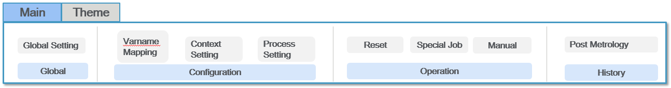
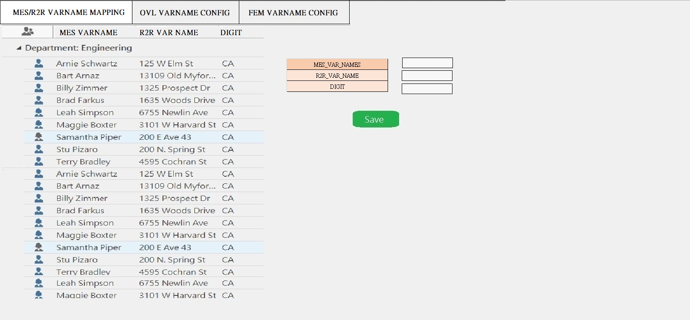
Varname Mapping

Slide 57
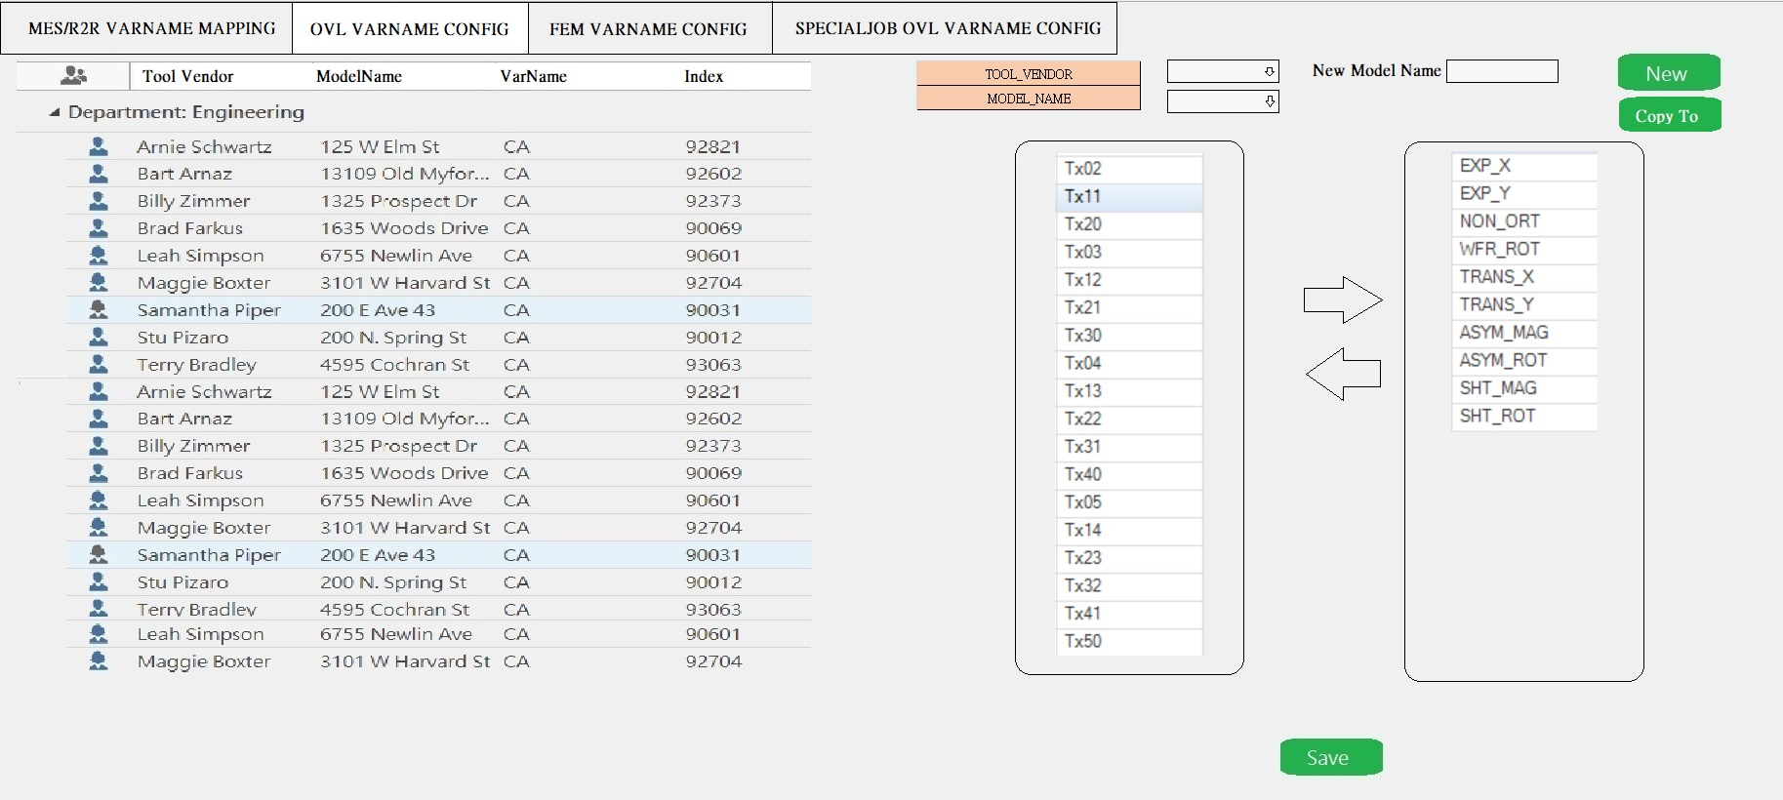

Varname Mapping

